Slide 1

SMART ELECTRICITY METER MONITORING AND PREDICTION – A CASE STUDY IN GHANA
KNUST
AFARI PRINCE
ASARE BAFFOUR SAMUEL NANA

Slide 2

2
TABLE OF
2
Larissa
Samuel
3 INTRODUCTION
6 PROBLEM DEFINITION
8 OBJECTIVES
9 LITERATURE REVIEW
10 METHODOLOGY

Slide 3

INTRODUCTION
3
3
The evolution of Technology
The Metering System

Slide 4
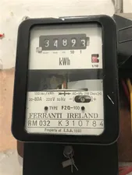
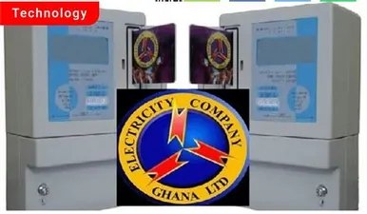
INTRODUCTION CONT’D
4
Larissa
Samuel
A mechanical meter
An electronic meter

Slide 5
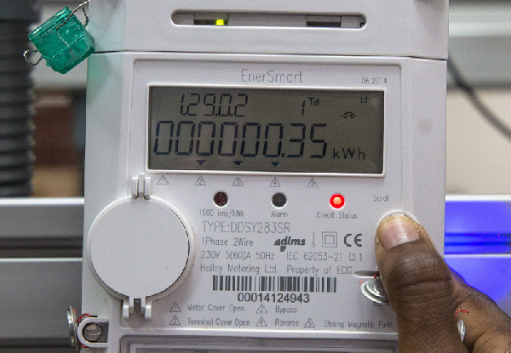
INTRODUCTION CONT’D
5
A smart meter

Slide 6
PROBLEM DEFINITION
1
2
Absence of energy consumption data.
Inconveniencies faced by customers

Slide 7
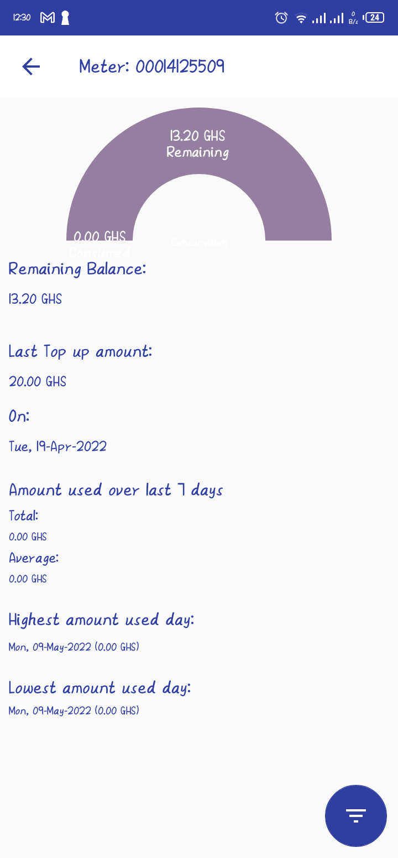
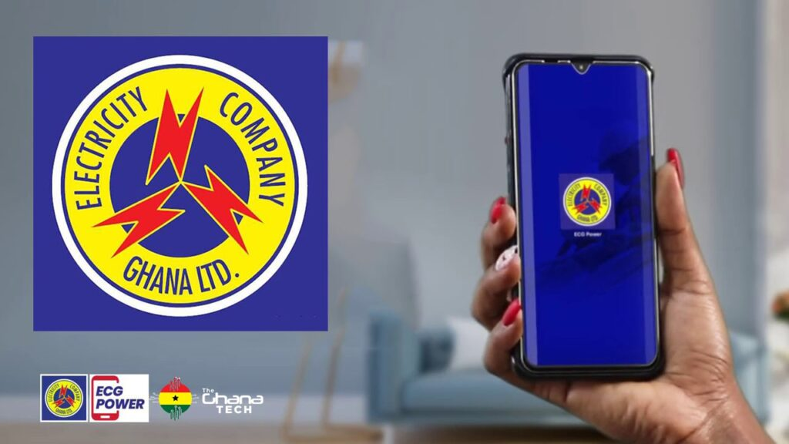
SOURCE: ECG POWER APP

Slide 8
OBJECTIVES
GENERAL RESEARCH OBJECTIVE
Build a model for providing and forecasting useful electricity consumption data
SPECIFIC RESEARCH OBJECTIVES
Electricity consumption pattern.
Electricity consumption prediction.

Slide 9
REVIEW OF RELATED WORKS
AUTHOR(S) | TITLE
Aaroosh Pandoh Aditya Santosh Wasekar Shubham Sarkar Anit Basu Thakur | Smart Electricity Meter Monitoring and Prediction using iSocket
Srikrishna Prasad Avinash S B | Smart meter data analytics using opentsdb and Hadoop
Grzegorz Dudek Anna Gawlak Mirosáaw Kornatka Jerzy Szkutnik | Analysis of Smart Meter Data for Electricity Consumers

Slide 10




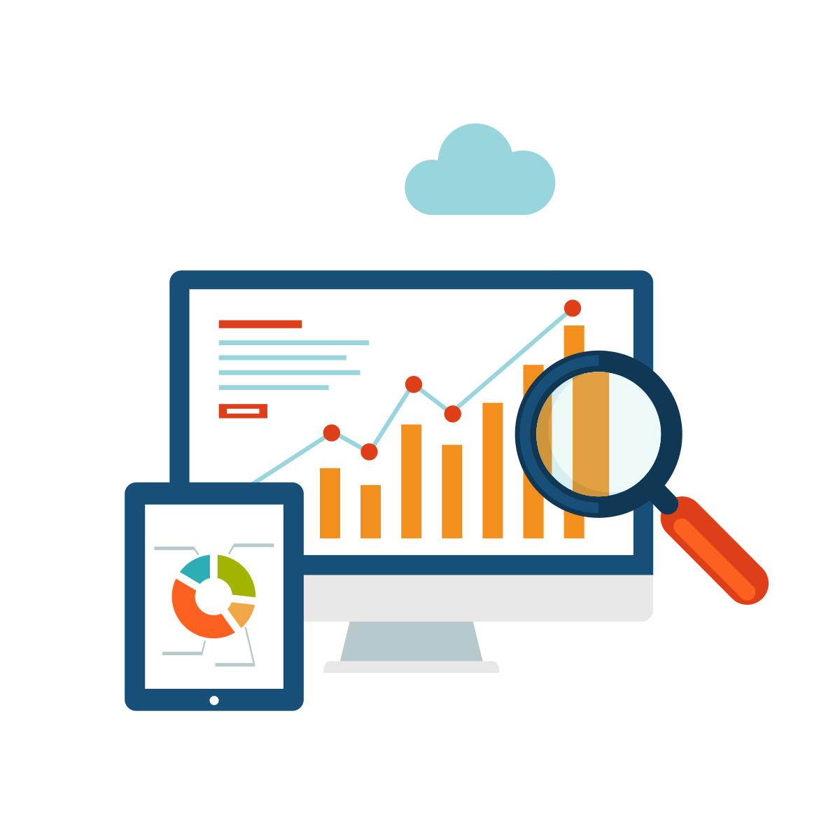


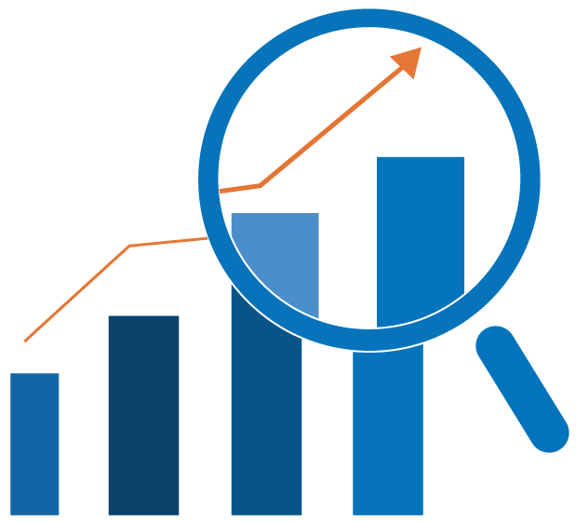
DATA EXPLORATION
ANALYTICS AND PREDICTION
METHODOLOGY
RESULTS AND VISUALIZATION
DATA CLEANING AND NORMALIZATION
LOAD
DATABASE
ANALYSIS
INTEGRATION OF ANALYTICS WITH A SYSTEM
VISUALIZATION
DATA GATHERING
FORECASTING MODEL
(HTTP REQUESTS)
WEB APP
API
DATA SOURCE:

Slide 11
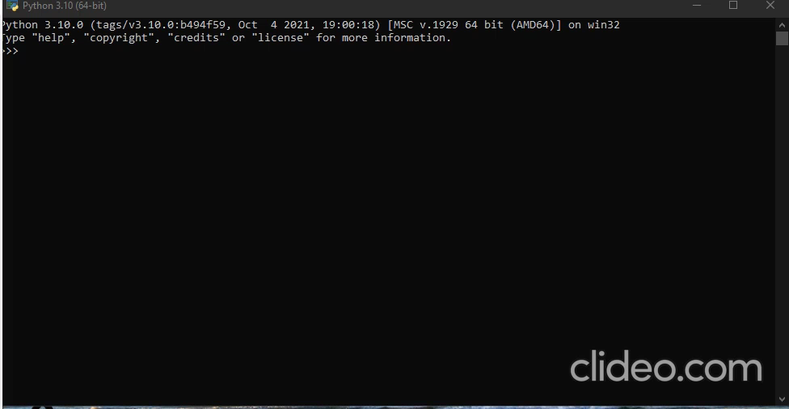

Slide 12
ARCHITECTURE FOR WEB APPLICATION
DATABASE/STORAGE
BACKEND
CONNECTION
SCREEN
ANALYTICS AND PREDICTIVE MODEL
DISPLAY OF CONSUMPTION ANALYSIS
METER NUMBER INPUT
DISPLAY OF PREDICTION RESULTS

Slide 13




TOOLS
PYTHON
HTML,CSS AND JAVASCRIPT
POSTGRESQL
DJANGO

Slide 14
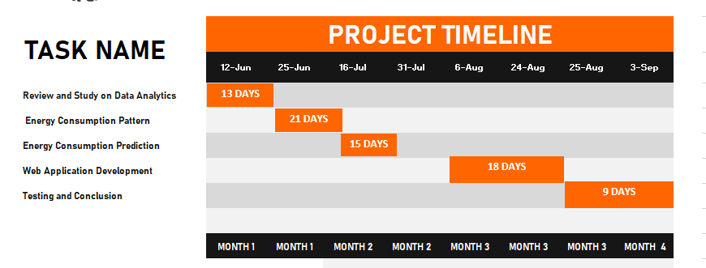
JUNE 2022 – SEPTEMBER 2022

Slide 15
THANK YOU ☺

